Slide 1


Job Board Website
Supervised By : Dr Eid Emary
Presented by: Yahya Ahmed Mahran
ID: 2051711498

Slide 2
Contents of this template
A job board is a website or online platform where employers can post job openings and job seekers can search for and apply for jobs. Job boards can be general or specialized, and they can be free or paid to use.
This job board project was created to help people find jobs and hire for jobs. It is a free and easy-to-use platform that allows employers to post job openings and job seekers to search for and apply for jobs.

Slide 3
Project Idea
Finding a job can be difficult and time-consuming, both for employers and job seekers
Existing job boards can also be difficult to use and navigate. Employers may find it difficult to post job openings and to find qualified candidates.
Your job board project aims to solve the following problems:
It provides a single platform for employers to post job openings and for job seekers to search for and apply for jobs.

Slide 4
It makes it easy for employers to post job openings and to find qualified candidates
It makes it easy for job seekers to search for jobs and to apply for jobs.
It provides more relevant and targeted job results for job seekers than existing job boards.
This problem definition is clear, concise, and informative.
It also explains how your job board project will solve the problems that it identifies.

Slide 5
Suggested Solution
The proposed solution for the job board project involves developing a user-friendly website or online platform where employers can post job openings and job seekers can search for and apply to jobs.
platform should have various features catering to both employers and job seekers, including job posting with detailed descriptions, candidate qualifications, and application instructions
Job seekers can create profiles, upload resumes, search for jobs using various criteria, save favorite jobs, and receive notifications for new relevant postings.

Slide 6
Related Applications
Examples of related work for a job board website include Indeed, LinkedIn Jobs, Monster, CareerBuilder, ZipRecruiter, Glassdoor, SimplyHired, Naukri.com, Seek.com.au, JobStreet.com, and CareerJunction
The first step involves studying similar job board websites to uncover opportunities for differentiation.
The second step is to research industry trends and challenges, such as the impact of job boards, social media and AI use, especially in developing countries.
The third step focuses on improving user experience by exploring the latest job search technology trends and gathering feedback from job seekers and employers. This ensures the website is user-friendly and meets the needs of all stakeholders.

Slide 7
Comparative Analysis
Feature | JobConnect | LinkedIn | Indeed | Glassdoor
Target Audience | Professionals of all levels, with a focus on niche markets and underrepresented groups. | Professionals across industries, with emphasis on high-level positions. | Job seekers of all levels and backgrounds. | Job seekers and employees, with a focus on company culture and insights.
Features & Functionalities | Advanced search with skills matching and AI-powered recommendations, personalized job boards and career coaching, employer branding tools, community forums for networking. | Robust professional network, company pages with job postings and employee reviews, advanced search filters, learning and development resources. | Massive job listing database, keyword search and salary comparison tools, resume builder and application tracking system (ATS) integration). | Company reviews, salary insights, interview questions, employee benefits comparison, employer branding tools.
Pricing & Revenue Model | Freemium model with basic features free and premium features available through subscription or pay-per-listing. | Freemium model with basic features free and premium features like sponsored listings and inMail available through subscription. | Free to use for job seekers, revenue generated through employer advertising and sponsored listings. | Free to use for job seekers, revenue generated through employer advertising, sponsored listings, and premium company pages.
User Interface & Experience (UI/UX) | Modern, user-friendly interface with intuitive navigation and personalized dashboards. | Professional and network-oriented interface, focus on connecting users with relevant opportunities and information. | Simple and search-oriented interface, prioritizes ease of finding relevant job postings. | Informative and review-driven interface, focus on transparency and employer reputation.
Unique Selling Points (USPs) | Niche focus and commitment to underrepresented groups, AI-powered matching and career coaching, strong community building features. | Extensive professional network and learning resources, employer branding tools and company page customization. | Largest job listing database and salary comparison tools, ATS integration and resume builder. | Focus on company culture and transparency, employee reviews and interview insights, employer branding tools.

Slide 8
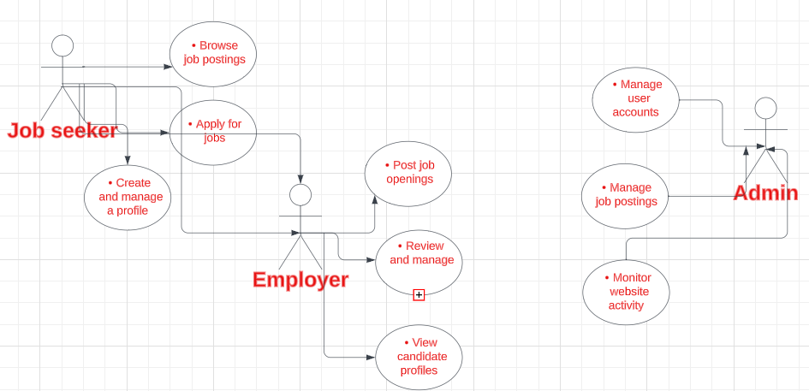
Analysis (Diagrams) Use case Diagram

Slide 9
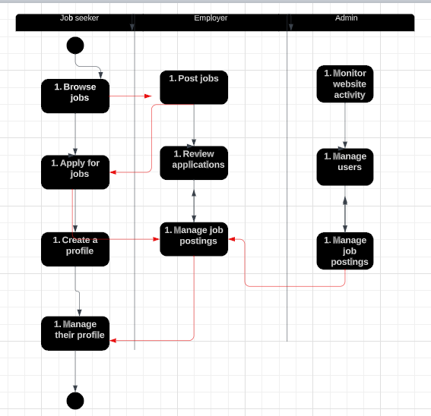
Activity diagram

Slide 10
The code of ethics for a job board website should ensure that the website is fair, accurate, transparent, and responsive to the needs of its users. The website should also be compliant with all applicable laws and regulations and maintain a high level of professionalism. Additionally, the website should promote social responsibility and diversity.

Slide 11
Software and hardware Requirements
. Hardware requirements:
8 GB of primary memory with 256 GB of secondary storage.
A system with a multicore Intel CPU
Software requirements:
Python
Django
Html
Css
Js
Bootstrap
Api
Chatboat Ai
Jeson

Slide 12
Thanks!
Do you have any questions?
yahmdh6@gmail.com
01001404850

